Slide 1
CHAPERT 1
LLM Fundamentals with LangChain
2026 Fall
조상구교수

Slide 2
Contents
Deep Learning Timeline
Vectorized String Operations : Text Mining
NLP(Natural Language Processing) : 자연어 처리
LLM(Large Language Model) : 대규모 언어 모델
Langchain, Langraph
Runnable
Agent

Slide 3
Python

Slide 4
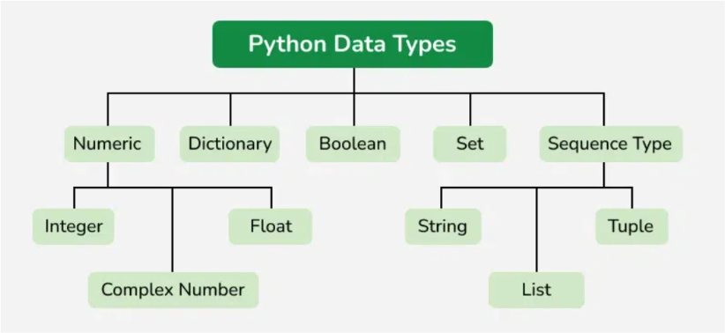
4
Python Data Types
https://www.geeksforgeeks.org/python/python-data-types/

Slide 5
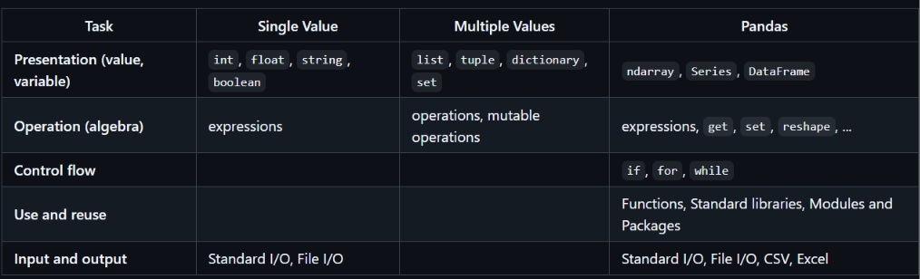
5
Python data & operation

Slide 6
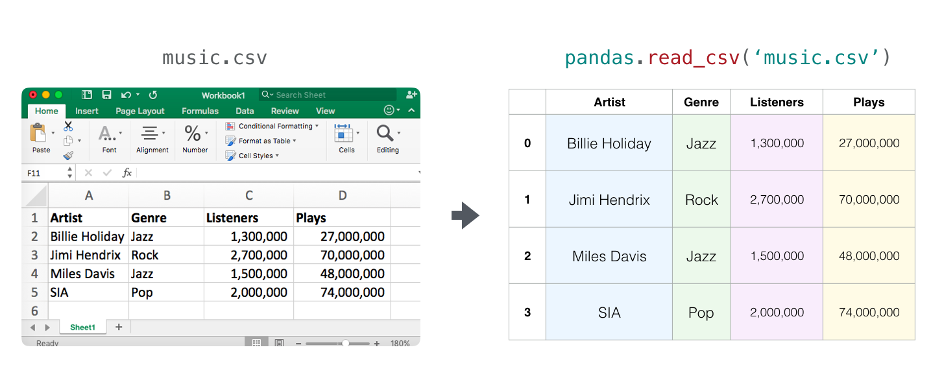
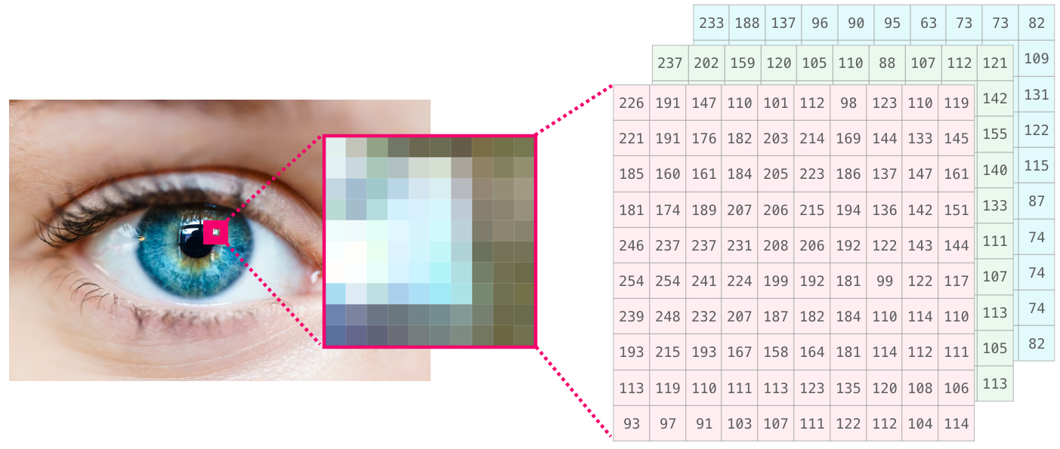
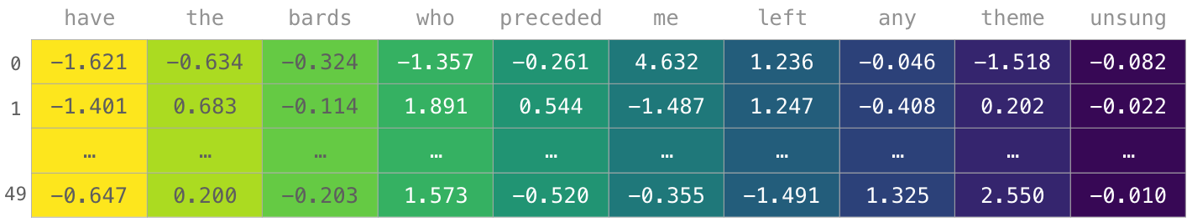
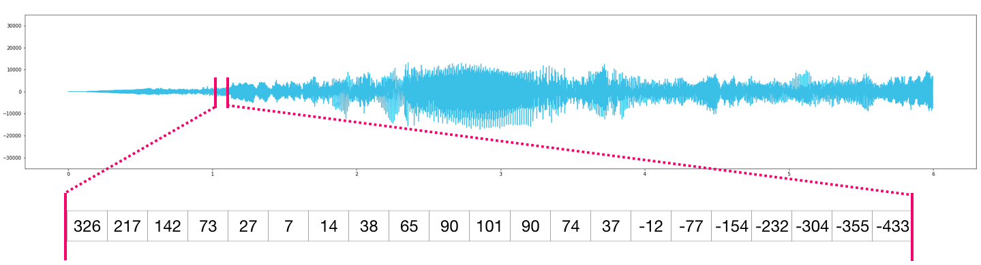
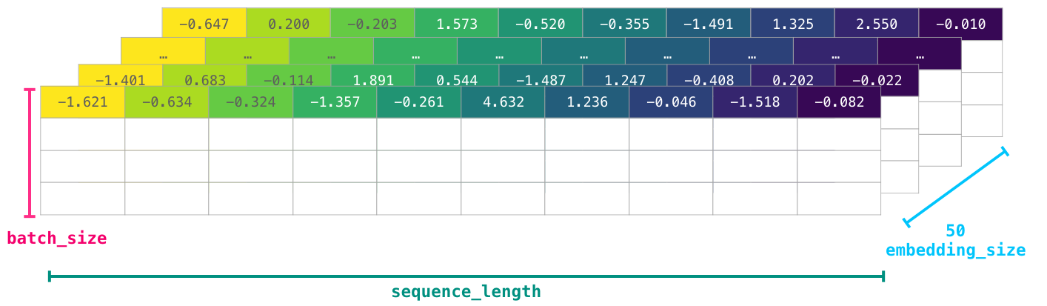
Big Data Types

Slide 7
CPU, Memory

Slide 8
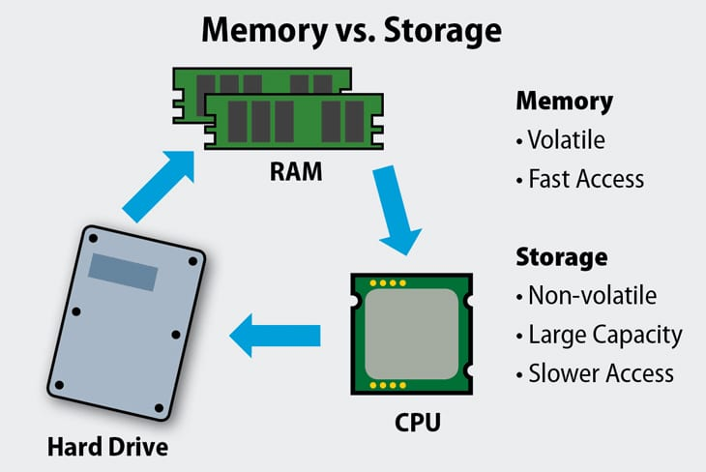
컴퓨터 CPU, Memory

Slide 9
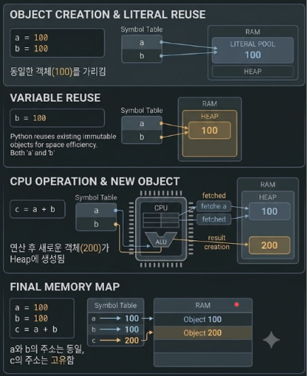
컴퓨터 CPU, Memory

Slide 10
File

Slide 11
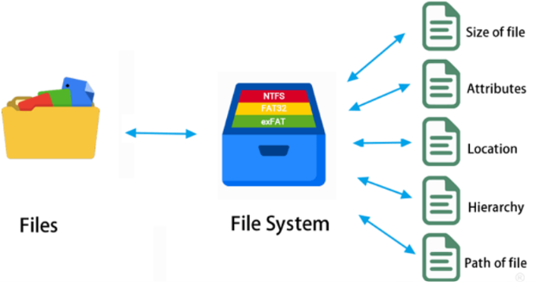
11
File system
https://www.easeus.com/partition-master/file-system.html?srsltid=AU7gw4UwDvmsRAe2Yk4dnwlgJ5fjRWyjaWdId_Ie_9RbpTScXABnmdLB

Slide 12
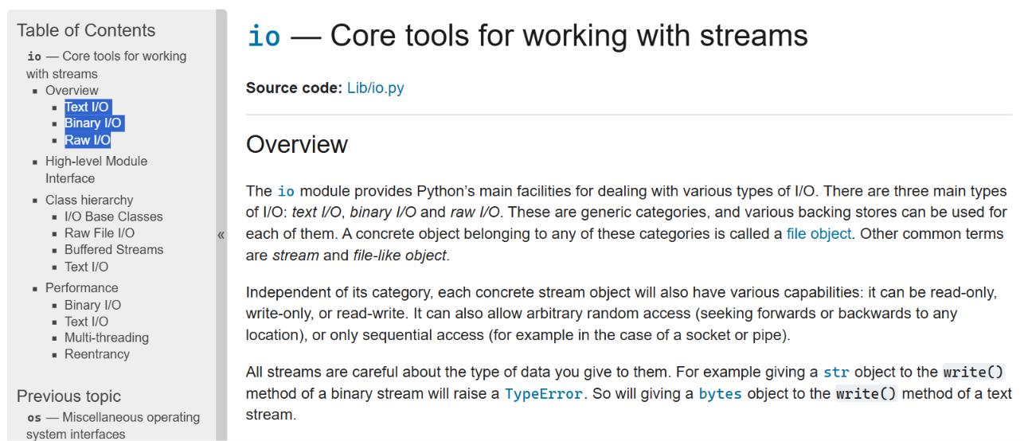
12
io – core tools for working with streams
https://docs.python.org/3.9/library/io.html

Slide 13
stream, buffer

Slide 14
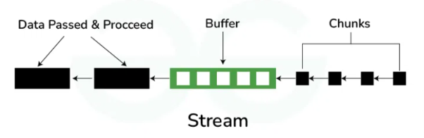
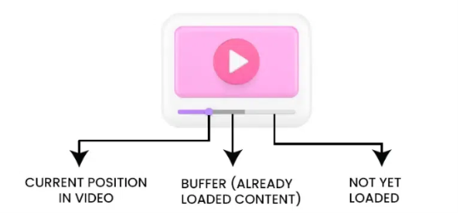
Stream & Buffer
https://www.geeksforgeeks.org/system-design/buffering-in-streaming-services/

Slide 15
Database

Slide 16
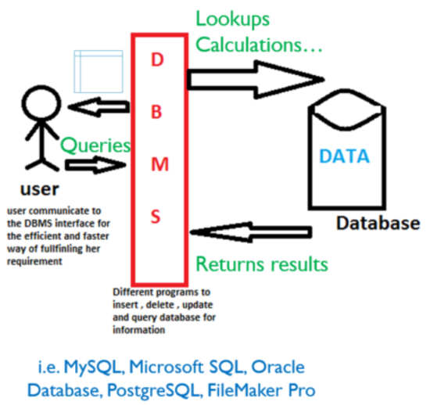
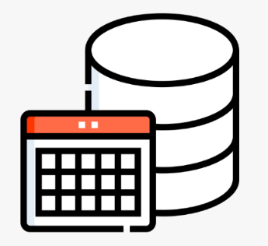
Database

Slide 17
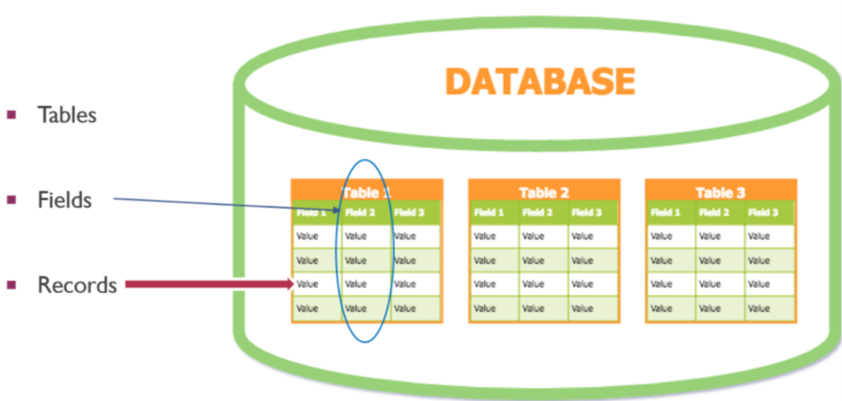
SQL(Structured Query Language)
SELECT family, personal FROM Person;
https://hbs-rcs.github.io/sql-novice-survey/01-select/index.html

Slide 18
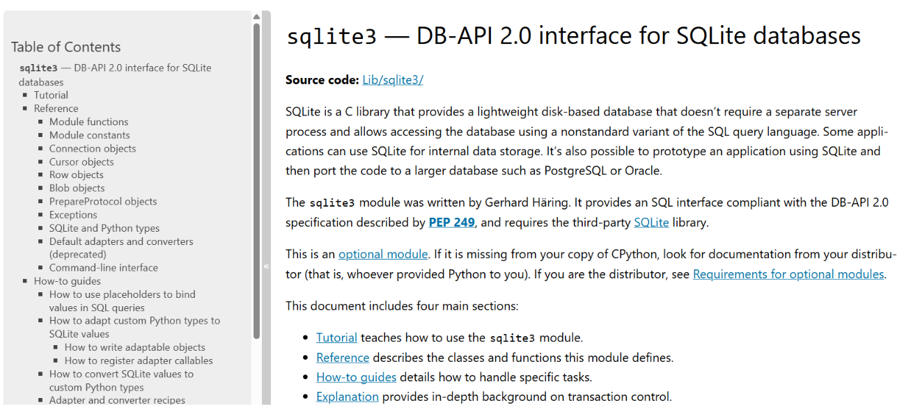
sqlite3
https://docs.python.org/3/library/sqlite3.html

Slide 19
client - server

Slide 20
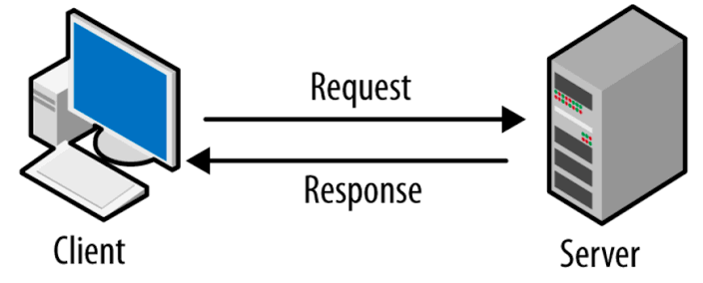
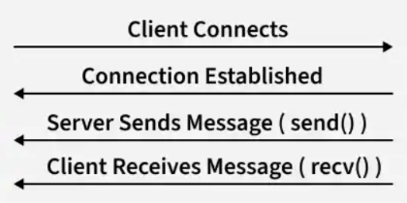
client server architecture

Slide 21
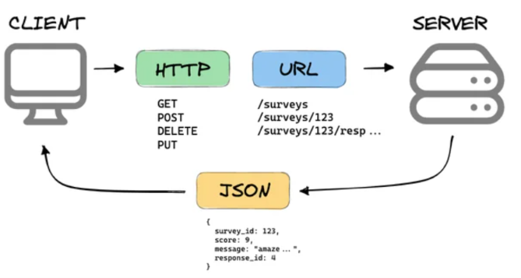
REST API

Slide 22
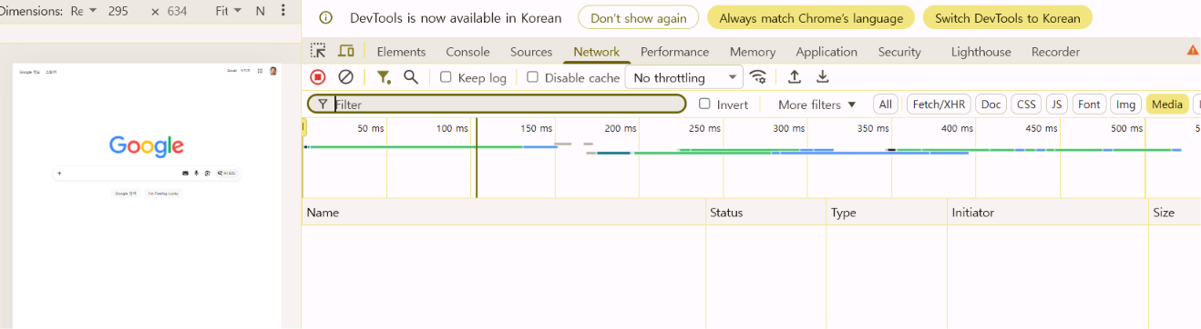
REST API

Slide 23
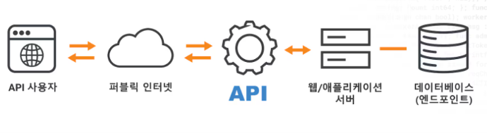
API

Slide 24
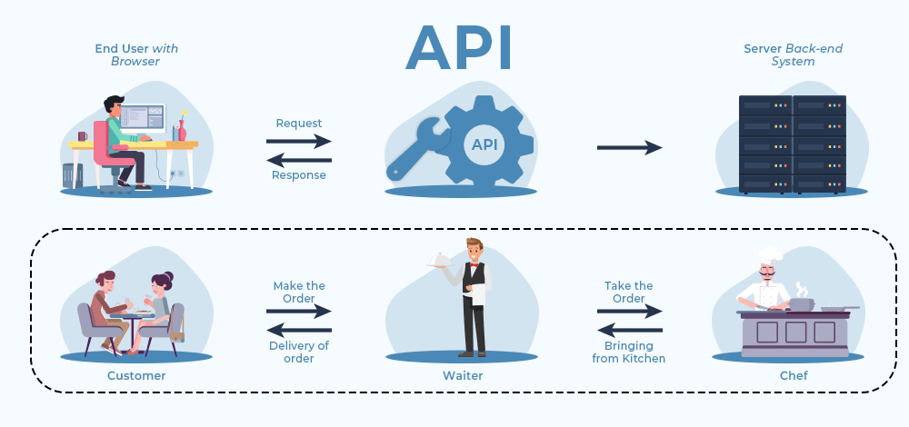
API

Slide 25
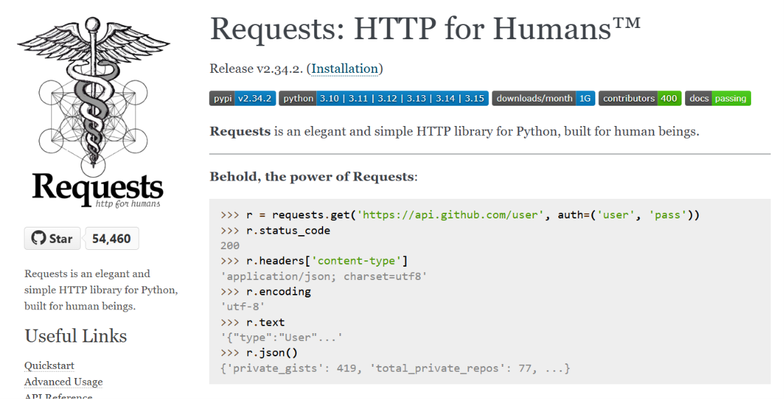
requests
https://requests.readthedocs.io/en/latest/

